Slide 1


Xcode Career Service
关注 Xcode 即可获得热腾腾的高频题解析视频、面试技巧及准备tips、北美IT就业咨询等干货
一对一实习或工作信息咨询服务
一对一面试能力评定 + 修改简历
一对一Mock interview强化训练服务

Slide 2
想进 xcode 的刷题群，请加老师微信 singerdmx， 他会拉你进群

Slide 3
Mock
FB 高频题：
Wild Card Match
（该wild card只有*、英文字母和数字）
用 Trie 实现

Slide 4
Docker 简介

Slide 5


Slide 6


Slide 7


Slide 8


Slide 9


Slide 10


Slide 11
Who gives birth to Docker
Evolvement of Unix
Cgroups (Control Group)
Union File System

Slide 12
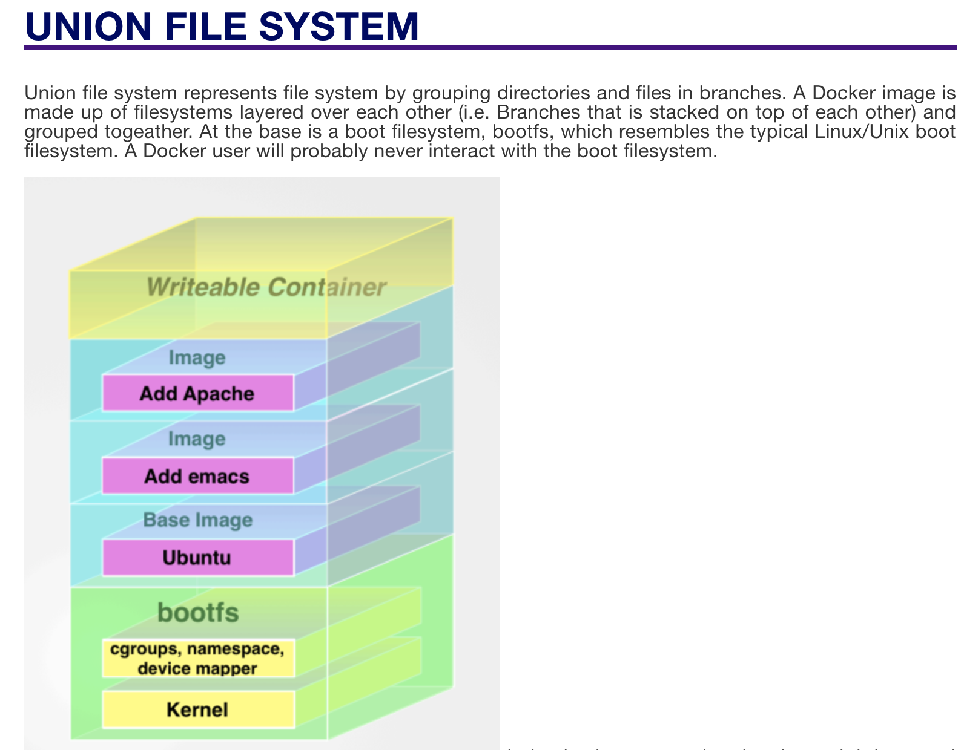
Notes:
https://washraf.gitbooks.io/the-docker-ecosystem/content/Chapter%201/Section%203/union_file_system.html

Slide 13
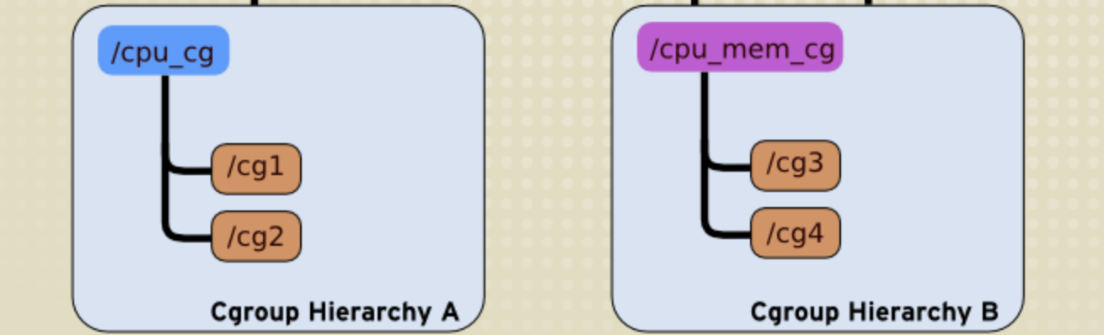
cgroups (abbreviated from control groups) is a Linux kernel feature that limits, accounts for, and isolates the resource usage (CPU, memory, disk I/O, network, etc.) of a collection of processes.

Slide 14
DP 核心思想
（1） Deduction Formula
（2） Initialization
（3） Space Improvement (Bonus)

Slide 15
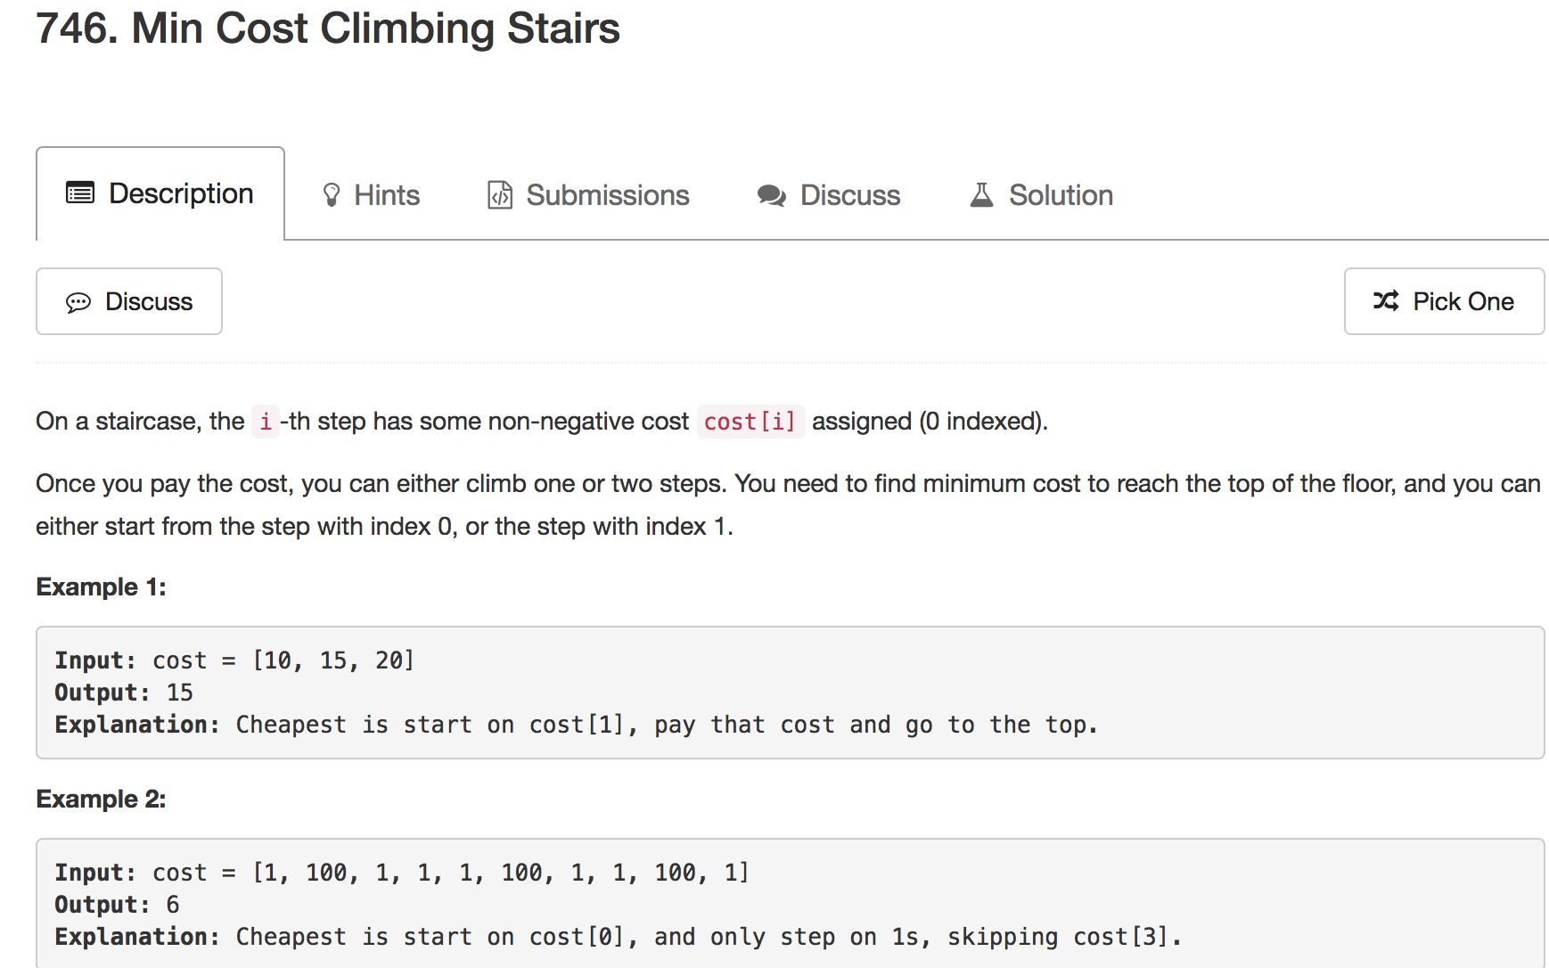

Slide 16
(1) Deduction Formula
0 | 1 | 2 | … | n - 2 | n - 1 | top
cost
f
0 | 1 | 2 | … | n | n + 1 | top
f[i] corresponds to cost[i + 2]
f[i] = cost[i + 2] + min(f[i - 1], f[i - 2])

Slide 17
(2) Initialization
0 | 1 | 2 | … | n - 2 | n - 1 | top
cost
f
0 | 1 | 2 | … | n | n + 1 | top
f[0] = 0, f[1] = 0
i starts with 2

Slide 18
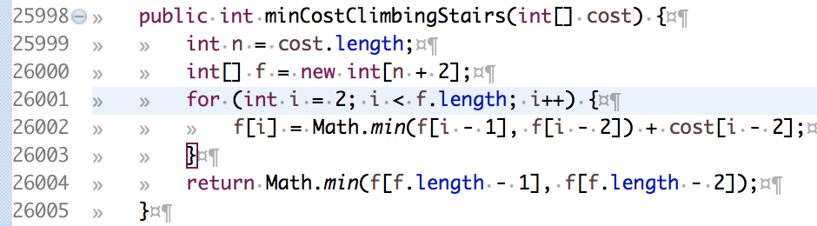
0 | 1 | 2 | … | n - 2 | n - 1 | top
cost
f
0 | 1 | 2 | … | n | n + 1 | top
top = min( f[last], f[second to last] )

Slide 19
(3) Space Improvement
0 | 1 | 2 | … | n - 2 | n - 1 | top
cost
f
0 | 1 | 2 | … | n | n + 1 | top
f2
f[i – 2]
f1
f[i – 1]
f0
f[i]

Slide 20
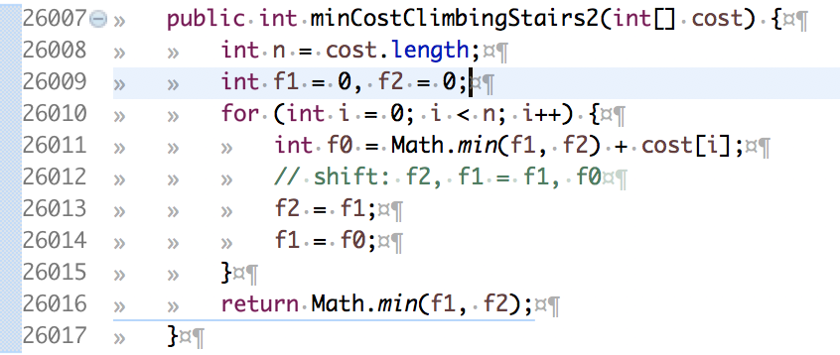
(3) Space Improvement
0 | 1 | 2 | … | n - 2 | n - 1 | top
cost
f
0 | 1 | 2 | … | n | n + 1 | top
f2
f[i – 2]
f1
f[i – 1]
f0
f[i]

Slide 21
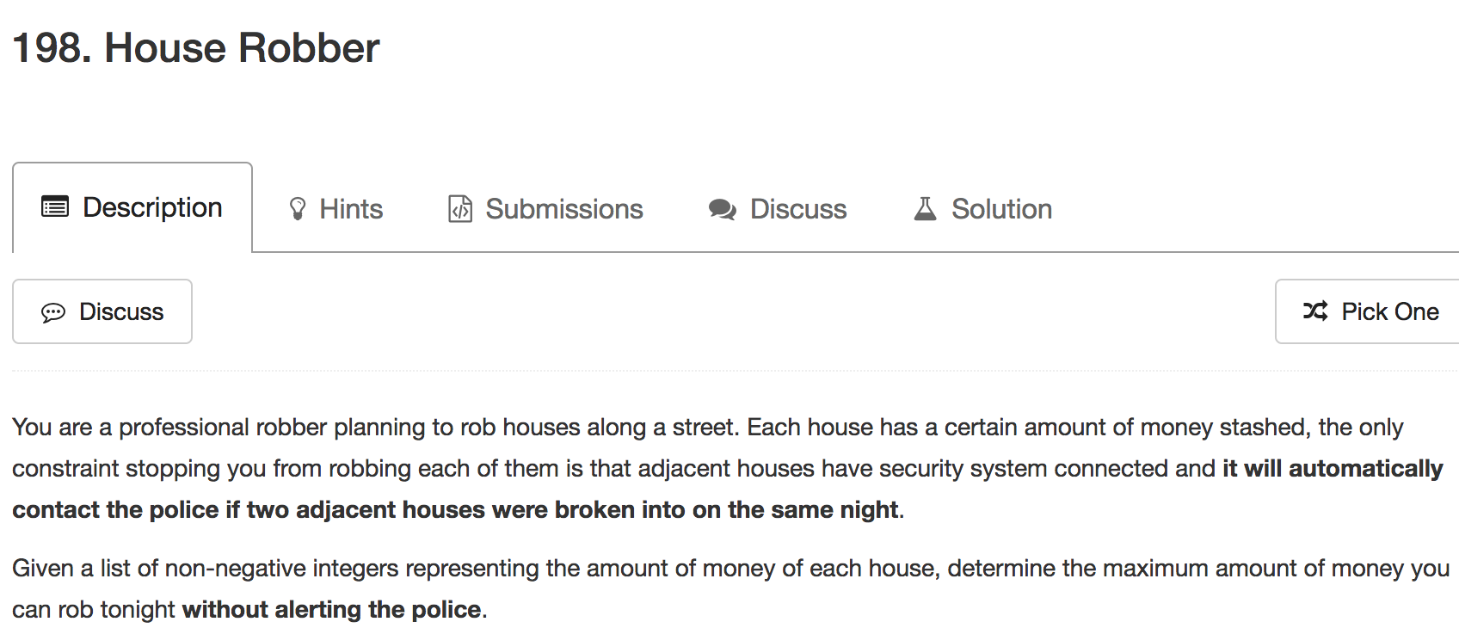

Slide 22
(1) Deduction Formula
f[i] = max(num[i] + f[i - 2], f[i - 1])

Slide 23
(2) Initialization
f[0] = 0, f[1] = 0
i starts with 2

Slide 24
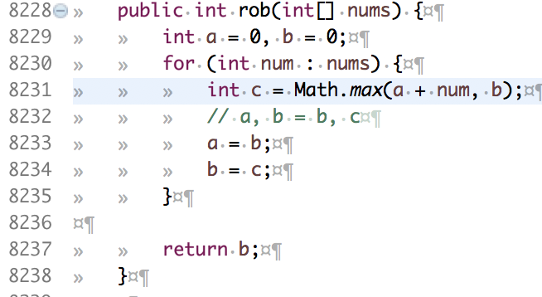
(3) Space Improvement
f[i] = max(num[i] + f[i - 2], f[i - 1])
f[i]: c
f[i - 1]: b
f[I - 2]: a

Slide 25
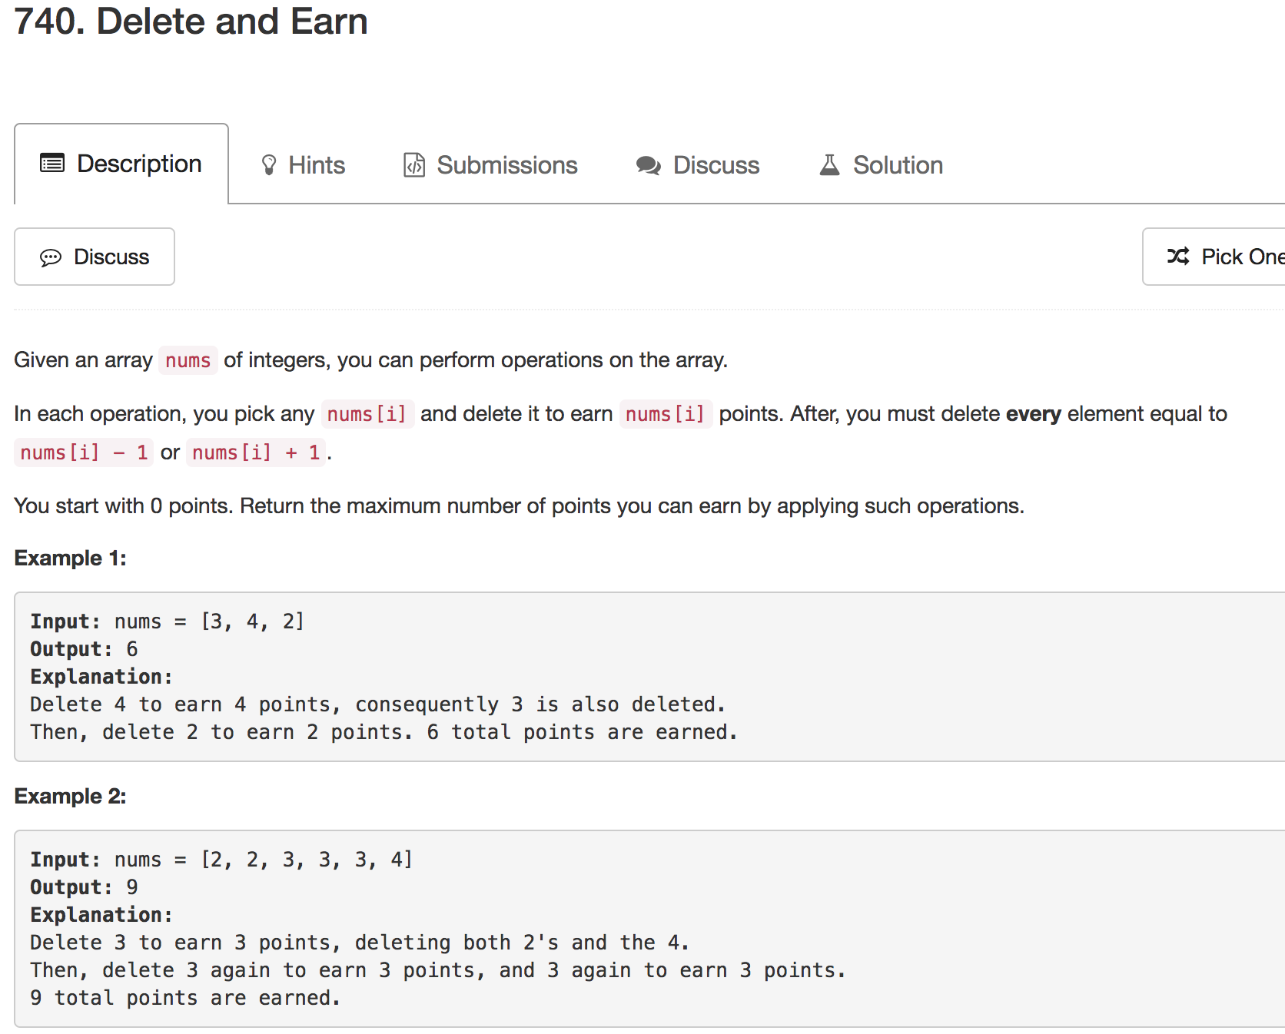

Slide 26
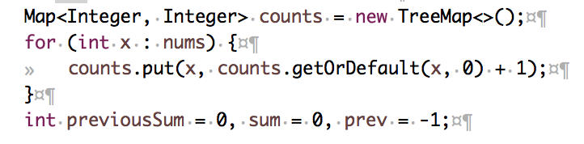
(1) Deduction Formula
if we "take" a number (use it to score points), we might as well take all copies of it, since we've already erased all its neighbors
nums = [2, 2, 3, 3, 3, 4, 7]
counts: {2=2, 3=3, 4=1, 7=1}

Slide 27
(1) Deduction Formula
nums = [2, 2, 3, 3, 3, 4, 7]
counts: {2=2, 3=3, 4=1, 7=1}
f[i] = max(num[i] + f[i - 2], f[i - 1])
f[i]: c
f[i - 1]: b
f[I - 2]: a
num[i]: current number * count

Slide 28
(1) Deduction Formula
counts: {2=2, 3=3, 4=1, 7=1}
iterating counts
f[i - 2]
a
f[i - 1]
b
f[i]
c

Slide 29
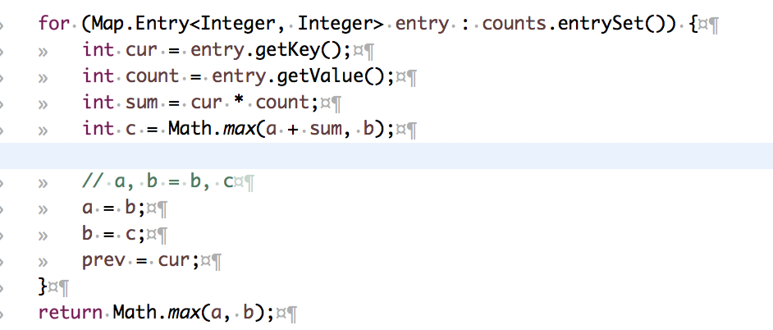

Slide 30
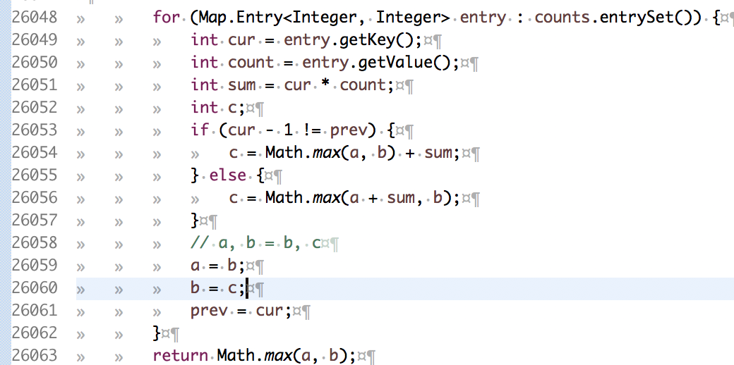

Slide 31
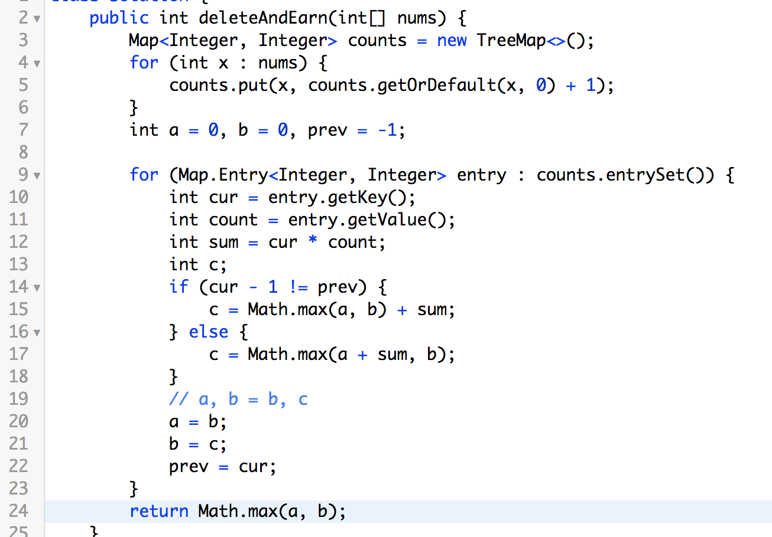

Slide 32
Xcode Career Service
有任何疑问请发邮件至 xc0d3@outlook.com 咨询

